Slide 1
AVCO-BLANKINOL COM-LT
BLEACHING AT LOW TEMPERATURE

Slide 2
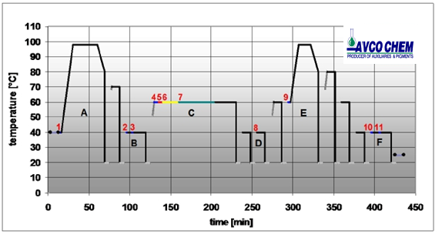
STANDARD PROCESS
fabric quality | 100% Co knit. fab.
weight p. run. met. | 200 g/rm
m² weight | 143 g/m²
fabric width | 140 cm
batch length | 2500.0 m
rope length | 625.0 m
liquor retention | 2.5 l/kg
circulation time | 2.8 min
A: 98°C Bleaching
Products |  | amount
1 detergent 1 peroxide stabilizer 1 peroxide 50% 1 NaOH 50% | % % % % | 0.8 0.6 2.0 3.0
B: Neutralisation / Catalase treatment
Products |  | amount
2 ACETIC 3 AVCOSAN 3EP | % % | 1.5 0.4
4 AVCOSLIP RF 4 AVCO LEVELLER 1488 5 common salt 6 REACTIVE DYE 7 soda ash 7 NaOH 50% | g/l g/l g/l % g/l ml/l | 1.0 2.0 60.0 3.0 5.0 1.7
type of machine | Jet
batch size | 500 kg
liquor ratio | 8 :1
Liquor | 4000 l
speed of rotation | 220 m/min
winch speed | 220 m/min
chamber(s) | 4 piece
jet pressure | 0.3 bar
D: Neutralisation
Products |  | amount
8 acetic acid 60% | ml/l | 1.0
E: Soaping
Products |  | amount
9 soaping agent | g/l | 1.5
F: Fixing bath / Softener
Products |  | amount
10 acetic acid 60% pH 5 - 6 10 AVCOFIX FFC 11 AVCOSOFT NY | ml/l % % | 1 1-2 3-4

Slide 3
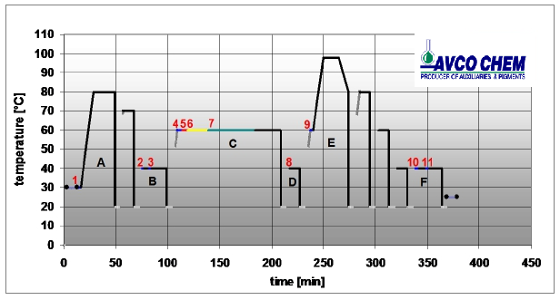
The low temperature bleaching is offering a pronounced save of energy consumption , along with save of machine time , labor cost , water and waste water treatment cost and increased machine efficiency.
Accelerates and reinforces the bleaching effect of hydrogen peroxide at 80c.
Optimal PH of 10-11
Minimum fiber damaging
Saving time – 1 HOUR SAVE PER CYCLE
Saving energy – OIL , ELECTRICITY BY APP. 13%
Reduced water consumption – BY APP. 15%
Softer fabric handle
Increased productivity – BY APP. 14%
Discontinuous half bleaching of cotton and cotton blends at L:R 1:5-1:15.
At 80c for 20-30 min. followed by a 70c rinse and neutralization/peroxide killer treatment.
BLANKINOL COM-LT
Bleaching at low temperature
fabric quality | 100% Co knit. fab.
weight p. run. met. | 200 g/rm
m² weight | 143 g/m²
fabric width | 140 cm
batch length | 2500.0 m
rope length | 625.0 m
liquor retention | 2.5 l/kg
circulation time | 2.8 min
A: 80°C Bleaching
Products |  | amount
1 BLANKINOL COM-LT 1 peroxide 50% 1 NaOH 50% | g/l cc/l cc/l | 1.5 4.0 2.0
B: Neutralisation / Catalase treatment
Products |  | amount
2 ACETIC 3 AVCOSAN 3EP | % % | 1.5 0.4
4 AVCOSLIP RF 4 AVCO LEVELLER 1488 5 common salt 6 REACTIVE DYE 7 soda ash 7 NaOH 50% | g/l g/l g/l % g/l ml/l | 1.0 2.0 60.0 3.0 5.0 1.7
type of machine | Jet
batch size | 500 kg
liquor ratio | 8 :1
Liquor | 4000 l
speed of rotation | 220 m/min
winch speed | 220 m/min
chamber(s) | 4 piece
jet pressure | 0.3 bar
D: Neutralisation
Products |  | amount
8 acetic acid 60% | ml/l | 1.0
Accelerates and reinforces the bleaching at 80°C.
Minimum fiber damaging and Softer fabric handle
Saving time – 1 HOUR SAVING PER CYCLE
Saving energy – OIL & ELECTRICITY by about 13%
Reduced water consumption – by about 15%
Increased productivity – by about 14%
E: Soaping
Products |  | amount
9 AVCORON WXF | g/l | 1.5
F: Fixing bath / Softener
Products |  | amount
10 acetic acid 60% pH 5 - 6 10 AVCOFIX FFC 11 AVCOSOFT NY | g/l % | 1-2 3-4

Slide 4
AVCO-BLANKINOL COM-LT
"ONE-SHOT" LOW TEMPERATURE BLEACHING COMPOUND
AVCO-BLANKINOL COM-LT is a balanced blend of wetting agent, detergent, stabilizer and activator, formulated to offer the textile dye-house a complete "one shot" low temperature bleaching auxiliary, designed for peroxide bleaching at 80°c of cotton and cotton blends with hydrogen peroxide in jets and winch type machines.
The special activating additive added to the AVCO-BLANKINOL COM-LT accelerates and activates the bleaching effect of hydrogen peroxide and shortens the required bleaching time, and thus enables bleaching at low temperature such as 80°c instead of the usual peroxide bleaching temperature which is in the range of 95 – 110 °c.
Lower bleaching temperature process consumes less energy and saves machine time, which means lower production costs.
Lower bleaching temperature means also lower fibre damage, less pilling and softer handle.
The new LOW TEMPERATURE bleaching is offering a pronounced save of energy consumption along with save of machine time (app. 1 hour time save per cycle).
The result is lowering of direct bleaching costs by app. 20% along with pronounced increase of bleaching machine efficiency by app. 15%.
SPECIFICATIONS:
PROPERTIES & USES:
"One-Shot" product that can replace all surfactants, stabilizers, sequestering agents normally used in cotton hot bleaching process.
Lower bleaching temperature means lower energy consumption and shortening of the bleaching time. The result is lower production cost and improved efficiency.
Appearance | Clear, colourless to yellowish liquid.
Chemical nature | Blend of nonionic surfactants, stabilizers, defoaming additives and special organo-complex activator.
Ionic type | Nonionic
pH (10% sol.) | 3.5 – 5
Solubility | Miscible with water at any ratio.
Compatibility | Compatible with all chemicals normally applied in cotton bleaching. Good compatibility with water hardness and mild alkalis and acids.
Storage | When stored in closed original packages, stable for at least 12 months.

Slide 5
Very good detergency and emulsifying properties towards dirt, waxes and oils which present in raw cotton knits. The absorbency of the bleached fabrics is excellent.
Less handling and weighing in the dye house and saving of storage space.
Maximum reproducibility.
Softer fabric handle.
Lower tendency towards pilling.
Can be applied also for full bleaching of cotton with optical brighteners.
APPLICATION:
Half bleaching of 100% cotton knit in the jet (L.R. 1:10):
AVCO-BLANKINOL COM-LT 1.5 g/l
H₂O₂ (50%) 4 cc/l
Soda caustic (50%) 2 cc/l
Run at 80°C for 20 - 30 minutes.
Drop bath and rinse at 70 - 80°C.
Neutralize and continue with the enzymatic peroxide residues elimination with AVCO-SAN 3EP followed by dyeing in the same bath.
When bleaching grey good without pre-scouring, it is advisable to add first a de-aerating agent such as AVCO-TEX CAN (0.3 – 0.6 g/l), and if needed a bath lubricant such as AVCO-SLIP RF (1-2 g/l). Then load fabric and circulate for 5 min., and add the other bleaching auxiliaries and start the bleaching process.
Full bleaching with O.B. of 100% cotton knit in the jet (L.R. 1:10):
AVCO-BLANKINOL COM-LT 1.5 - 2 g/l
H₂O₂ (50%) 8 - 10 cc/l
Soda caustic (50%) 3 cc/l
AVCO-LUX HA 1 %
Run at 95 - 98°C for 45 - 60 minutes.
Drop bath and rinse at 70 - 80°C.
Remark:
Full bleach with O.B.A. at 80°C is possible, but will produce a full white with some lower whiteness degree. Preliminary tests are required.

